Slide 1
Chapter 6
Emotion and Affect

Slide 2
What is Emotion?
Emotion:
Conscious evaluative reaction to some event
How do emotions guide your behavior?
How do emotions provide you with feedback?
Mood:
Feeling state that is not clearly linked to some event
Affect:
Automatic response that something is good or bad (Positive and Negative Affect)

Slide 3
Conscious Emotion vs. Automatic Affect
Duplex Mind – Conscious and Automatic
Emotion
Conscious
Can include cognitions and bodily response
Takes time
Affect
Automatic, quick
Good vs. Bad
Initial evaluation

Slide 4
James-Lange Theory of Emotion
Stimulus
Bodily Reactions
Perception of those reaction to create emotional experience
Assumes that different bodily responses lead to different emotions.
Notes:
Figure 6.1 James-Lange theory of emotion: The emotional stimulus (e.g. hearing footsteps behind you in a dark alley) produces physiological arousal (e.g., increased heart rate), which then produces an experienced emotion (e.g., fear).

Slide 5
James-Lange Theory
Body = emotion
“Without the bodily states following on the perception, the latter would be purely cognitive in form; pale, colorless, destitute of emotional warmth. We might then see the bear, and judge it best to run... But we should not actually feel afraid.” (William James, 1890)
James, 1890, v. 2, p. 449 (Gleitman)
Notes:
If there’s no body, no emotion. “Without the bodily states following on the perception, the latter would be purely cognitive in form; pale, colorless, destitute of emotional warmth. We might then see the bear, and judge it best to run, receive the insult and deem it right to strike, but we should not actually feel afraid or angry.”
Now what James is saying is, the experience of an emotion is the experience of the body. If you don’t have a body, you can’t really have an emotion.
Think about it. Let’s say you have a crush on one of your classmates. Let’s say that Bob here has a crush on Jane [picking out two students who sit very far away from each other]. Now, when Jane walks by Bob, Bob maybe feels a little nervous. His heart starts beating a little faster, he sweats a little, he maybe even blushes, and he looks down at his books because he doesn’t want her SEEING him sweating and blushing and “OMG is she looking over here or not and WHEW I’m nervous...” Now, what if Bob didn’t have this bodily reaction? Can you have a crush on someone without having a bodily reaction when the come near? Would you say that it’s a real crush, if your heart doesn’t start beating a little faster?

Slide 6
Other Research
James-Lange Theory led to Facial Feedback Hypothesis
Facial expression can evoke or magnify emotions.
Studies:
Cartoon Ratings with pen in mouth
Botox patients
Zajonc, et al.
Making some sounds - “ah” and “e” - caused smiling and elevated mood.
Making other sounds - “u” and “ü” - caused frowning and lowered mood.

Slide 7
Facial-Feedback Hypothesis
Stimulus invokes physiological arousal including movement of facial muscles
Brain interprets facial expression which gives rise to your emotion
Sequence
Stimulus (See snake)
Make a face (fearful)
Brain reads face
Emotion (fear)

Slide 8
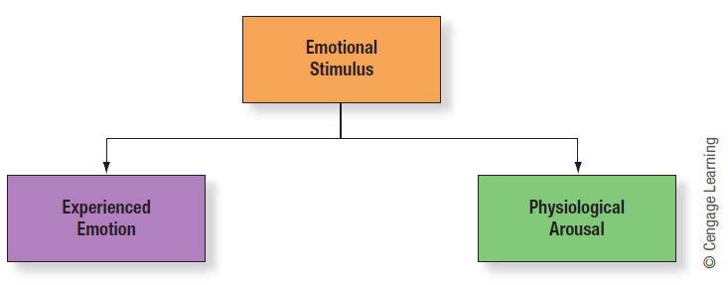
Cannon-Bard Theory of Emotion
Thalamus sends messages simultaneously to Cerebral Cortex and to Limbic System (Hypothalamus and ANS)
Notes:
Figure 6.3 Cannon-Bard theory of emotion: The emotional stimulus (e.g., hearing footsteps behind you in a dark alley) activates the thalamus. The thalamus sends two messages at the same time: one message to the cortex, which produces an experienced emotion (e.g., fear), and one message to the hypothalamus and autonomic nervous system, which produces physiological arousal (e.g., increased heart rate).

Slide 9
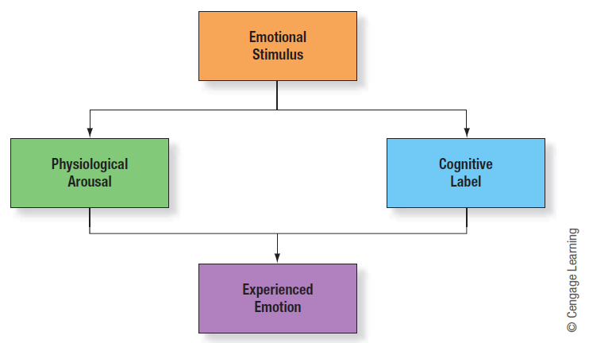
Schachter-Singer Theory of Emotion Two-Factor Theory
Notes:
Figure 6.4 Schachter-Singer theory of emotion. The emotional stimulus (e.g., hearing footsteps behind you in a dark alley) produces physiological arousal (e.g., increased heart rate) and a cognitive label, which produces an experimental emotion (e.g., fear).

Slide 10
Schachter-Singer Theory
Hypothesis: The same bodily reaction will cause one emotion in one situation, and another emotion in a different situation.
Give people a dose of adrenaline;
Informed vs. non-informed subjects
Non-informed subjects’ emotions were highly influenced by confederates’ emotions
Notes:
Of course, explained like this it might sound like it just “makes sense,” but as always, we would like a little bit of actual proof that this is what happens. To test the theory, we need a strong hypothesis that the theory would predict.
The Schachter theory assumes that the body cannot tell us exactly what we are or should be feeling. Instead, even if we have a fast bodily reaction to something, it is our mind that decides what the emotion will be. In other words, will the same bodily reaction be interpreted in different ways if you are in different situations?
Schachter & Singer did a very fun experiment to test exactly that question. Basically, they gave people a dose of adrenaline, which created a certain bodily reaction [beating heart]; but then they put them in different situations [bug/face]. The idea is that the cognitive appraisal of the situation should influence the emotion you feel. SO if you are with a giant bug, you’d feel fear; if you’re with a gorgeous man, you’d feel love. Or woman. In the pictures we’ve been using so far, we have bodily reaction; two DIFFERENT situations; and then two DIFFERENT emotions.

Slide 11
Misattribution of Arousal
Excitation Transfer
Arousal from one event is transferred to a later event.
Suspension vs. Stable Bridge
Misattribution of arousal turned fear into attraction.
What flaws in the design of the study could lead to questions of the results?

Slide 12
Happiness
What is happiness?
Feeling good
Can be described by affect balance: frequency of positive minus frequency of negative emotions
Life satisfaction
Broader and longer evaluation of happiness
Notes:
Technology Tip: Eighteen happiness related measures are available to those who register at Martin Seligman’s Authentic Happiness page (http://www.authentichappiness.sas.upenn.edu/Default.aspx/)
Technology Tip: The BBC maintains an extensive Happiness website containing articles, online tests, and brief videos (http://news.bbc.co.uk/2/hi/programmes/happiness_formula/default.stm)

Slide 13
National Happiness Ratings
The happiness scale : very happy (4), quite happy (3), not very happy (2), or not at all happy (1).

Slide 14
Objective Roots of Happiness
Objective Circumstances
Job, money, children, marriage, health, etc.
All seem to be weakly related to some happiness, except children.
Social Connections are the most related to happiness.
Hedonic Treadmill Theory
People stay at the same level of happiness.
Lottery winners and people who have been paralyzed after an accident.
Notes:
Technology Tip: Daniel Gilbert has written a short and very accessible article on happiness, money, and comparisons. It provides numerous examples illustrating why money doesn’t equal happiness. (http://www.forbes.com/2006/02/11/daniel-gilbert-happiness_cx_dg_money06_0214gilbert.html)

Slide 15
Wealth and Happiness
Over a 40-year period, Americans became over twice as wealthy, but no happier.

Slide 16
Subjective Roots of Happiness
Outlook on life.
How much money you make vs. how you feel about the money you make.
Being married vs. being happily married.
“Born Happy”
Best predictor of happiness is level of happiness 10 years prior.

Slide 17
Increasing Happiness
Positive Psychology
Forgiveness
Expressing gratitude
Focusing on good things in your life
Happy people are healthier
Live longer (7 to 10 years)

Slide 18
Tradeoffs: Affect Intensity, or the Joys of Feeling Nothing
Some people have many intense experiences while others have relatively few
Affect Intensity Measure (AIM)
If one has positive life circumstances, you have more enjoyment from high affective intensity
May intentionally lower affect to prevent being hurt

Slide 19
Anger
What is anger?
Angry people may:
Downplay risks and overlook the dangers of impulsivity
Fail to consider consequences of actions
In what ways is anger hurtful?

Slide 20
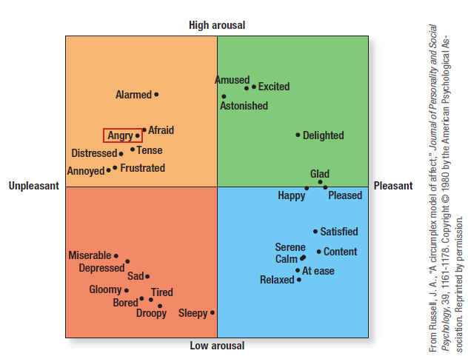
Notes:
Figure 6.5 Emotions can be sorted into four categories, defined by crossing the pleasant versus unpleasant dimension with the high versus low arousal dimension (Russell, 1980).

Slide 21
Causes of Anger
How does perceptions of others’ behaviors relate to anger?
What types of behaviors in others may perpetuate greater anger?
In what ways is anger helpful?
From an evolutionary standpoint, what role does anger play in survival?

Slide 22
Hiding vs. Showing Anger
In what situations does society encourage people to not show anger?
What are the drawbacks of venting anger, or exercising vigorously in response to anger?
How can people decrease arousal to reduce anger?
What are some best practices for dealing with anger?

Slide 23
Guilt and Shame
What is the difference between guilt and shame?
Which is constructive? Which is destructive?
What are the benefits and drawbacks to guilt and shame?
How do apologies and amends represent positive outcomes of guilt?
How can guilt strengthen relationships?

Slide 24
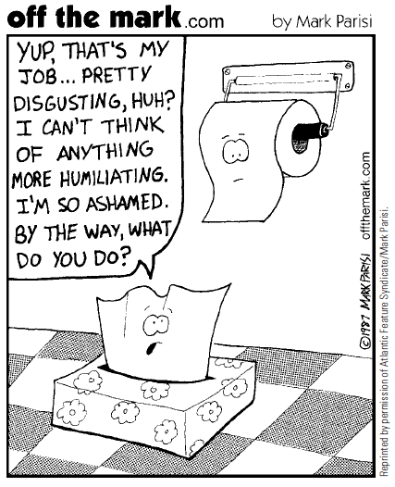

Slide 25
Guilt and Relationships
In what ways is guilt an interpersonal emotion?
Consider survivor guilt
People may try to make others feel guilty

Slide 26
Disgust
What is the purpose of disgust?
Consider disgust in men versus women
How can disgust motivate healthy behaviors?
How can public health officials take advantage of disgust?
Why do people feel more disgust towards strangers or different groups?
How can disgust influence moral judgments?

Slide 27
Why Do We Have Emotions?
Emotions:
Comprise powerful and important feedback system
Promote belongingness
Rarely cause behavior directly
Guide thinking and learning
Affect-as-information hypothesis: if I feel good about something, it must be good

Slide 28
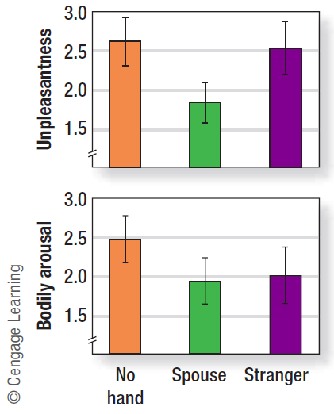
Notes:
Figure 6.6 Holding someone’s hand reduces how unpleasant stressful events are judged to be and even reduces bodily arousal, especially if the person is your spouse (Coan et al., 2006).

Slide 29
Emotions Guide Thinking and Learning
Emotions guide decisions and choices
Affective forecasting – Predicting one’s emotional reaction.
Help and Hurt
Risk-as-feelings hypothesis – react as if the worst situation occurred.
Risky behavior

Slide 30
Positive Emotions
Positive emotions are less prevalent, and they are studied less often
How, according to the broaden-and-build theory, do positive emotions solve problems of personal growth and development?

Slide 31
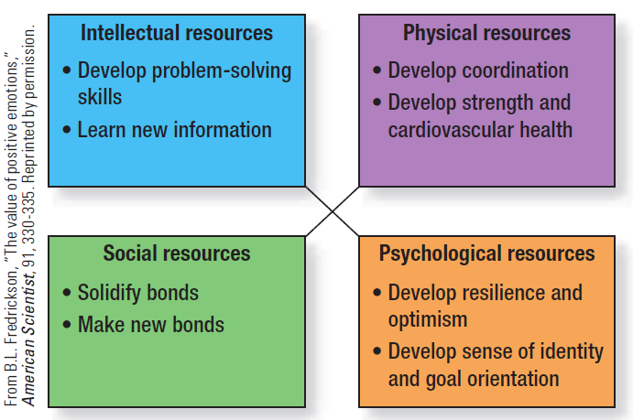
Notes:
Figure 6.7 Positive emotions broaden and expand an individual’s attention and mind-set. These broadened mind-sets, in turn, build an individual’s physical, intellectual, and social resources (Fredrickson, 2003).

Slide 32
Positive Emotions (cont’d.)
Benefits of being in a good mood
A good mood helps flexibility, creativity, and problem-solving
People in a good mood perform better, are more persistent, and more motivated
People in a good mood avoid risks
Drawbacks of being in a good mood
People in a good mood are less logical, have poorer short-term memory, and more easily distracted by irrelevant information

Slide 33
Emotions Different Across Cultures
How are emotions similar across cultures?
Six basic emotions: happiness, surprise, fear, anger, sadness, and disgust
People in many different cultures can identify facial expression of these emotions
Notes:
Technology Tip: Paul Ekman maintains an extensive website where he provides links to articles, related researchers, and other resources. Also included is a training video to help individuals detect early facial expression of emotions (http://www.paulekman.com/)

Slide 34
Cultural Differences in Emotion
Asian Americans place greater emphasis on emotional moderation than European Americans
How do people in collectivist and individualist cultures find self-worth?
How does culture teach people to hide emotions?
How might that affect studies on cross-cultural recognition of emotional facial expressions?

Slide 35
Are Women More Emotional Than Men?
Studies show that men are more emotional, but women are more willing to report emotions
Why do stereotypes regarding women’s greater emotionality persist, despite research findings to the contrary?

Slide 36
Arousal, Attention, and Performance
Is arousal good or bad for performance?
Under what circumstances can arousal cause an increase in performance? Under what circumstances can it decrease performance?
How does the strength of arousal affect performance?
What does this say about the effects of stress?

Slide 37
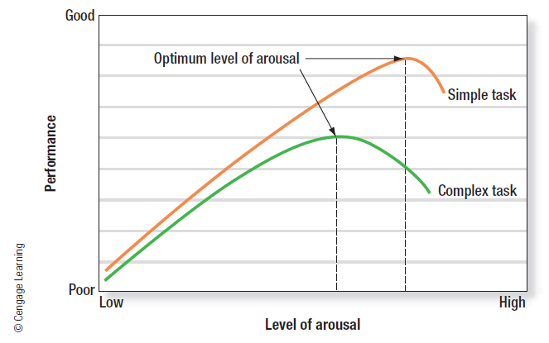
Notes:
Figure 6.8 According to the Yerkes-Dodson Law, some arousal is better than none, but too much can hurt performance.

Slide 38
Emotional Intelligence (EI or EQ)
Emotional intelligence: the ability to perceive, access and generate, understand, and reflectively regulate emotions
Mayer-Salovey-Caruso Emotional Intelligence Test (MSCEIT)
Perceiving Emotion
Facilitating Thought
Understanding Emotion
Managing Emotions
Notes:
Technology Tip: Daniel Goleman maintains an extensive website on emotional intelligence (http://danielgoleman.info/)

Slide 39
Affect Regulation Strategies
What are some things that people can do to alter their mood?
What are some things people do to deal with the problem?
How do these approaches differ? What are the strengths and weaknesses of each approach?

Slide 40
Goals of Affect Regulation
What are some affect regulation goals?
In what situations would a positive mood be undesirable? In what situations would a negative mood be desirable?
How do people regulate their mood prior to social interactions?
What gender differences exist for mood regulation?
Is affect regulation a good idea?

Slide 41
What Makes Us Human?
Human emotion is tied to meaning
Can respond emotionally to ideas and concepts
Leads to a larger range of emotion
Emotion aids in social acceptance/cognition
Provides feedback
Anticipated emotion used for decision making
EI provides power to regulate emotions

Slide 42
Conclusion
Emotions shape our behaviors and are accompanied by physiological arousal
Emotions can affect our lives, actions, and performance
Though there are many strategies for controlling mood, emotions serve an important function in our lives

