Slide 1
Chapter 5
Learning

Slide 2
Chapter Preview
Types of Learning
Classical Conditioning
Operant Conditioning
Observational Learning

Slide 3
Learning & Behaviorism
Learning
Systematic, relatively permanent change in behavior that occurs through experience
Behaviorism
Theory of learning that focuses solely on observable behaviors
Discounts importance of mental activity

Slide 4
Types of Learning
Associative Learning & Conditioning
Classical Conditioning
Association between two stimuli
Operant Conditioning
Association between behavior and consequence
Observational Learning
Observing and imitating another’s behavior

Slide 5
Classical Conditioning
Reflex: Automatic, without prior learning
Unconditioned Stimulus (UCS)
Unconditioned Response (UR)
Learning: Association, after pairing of stimuli
Conditioned Stimulus (CS)
Conditioned Response (CR)

Slide 6
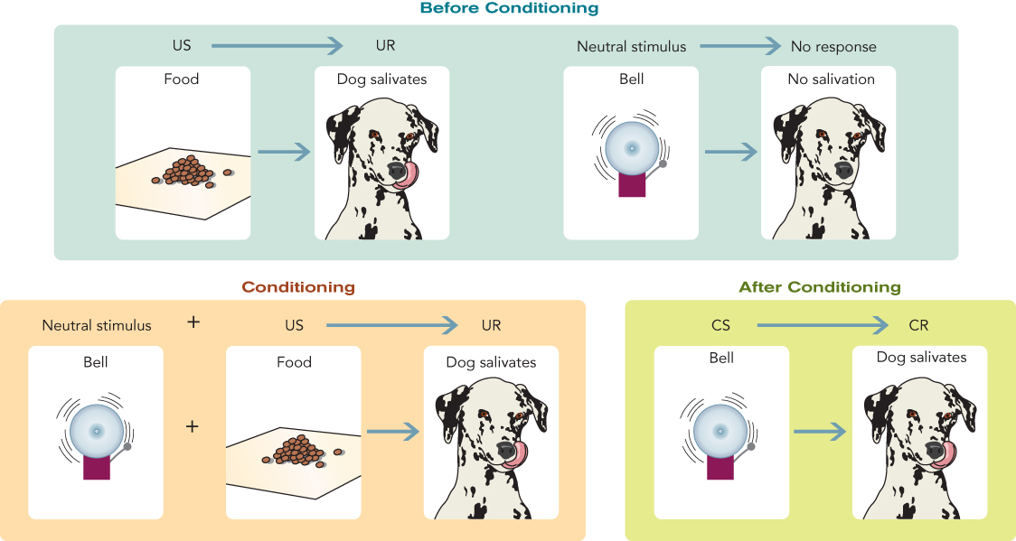
Pavlov’s Classical Conditioning

Slide 7
Classical Conditioning
Acquisition: Learning of connection between UCS & CS
Continguity: UCS & CS close in time
Contingency: CS as reliable indicator of US
Stimulus Generalization
Stimulus similar to CS elicits response similar to CR
Stimulus Discrimination
Process of learning to respond only to some stimuli

Slide 8
Classical Conditioning
Extinction
Weakening of CR when US is absent
Spontaneous Recovery
Recurrence of CR after time delay, without further conditioning

Slide 9
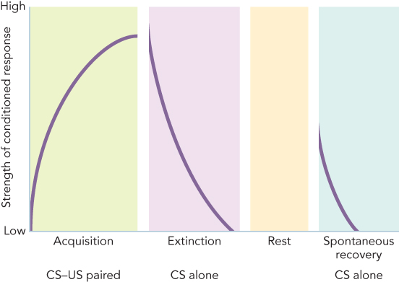
The Strength of a Classically Conditioned Response During Acquisition, Extinction, and Spontaneous Recovery

Slide 10
Classical Conditioning in Humans
Explaining and eliminating fears
Watson & Rayner: Little Albert
Counterconditioning
Immune and Endocrine Systems
Immunosupression
Taste Aversion Learning

Slide 11
Operant Conditioning
Classical Conditioning
Based on involuntary responses
Operant (Instrumental) Conditioning
Explains voluntary behaviors
B. F. Skinner
Consequences change probability of behavior
Consequences contingent on behavior

Slide 12
Operant Conditioning
The Skinner Box
Controlled conditions to study operant conditioning
Operant = Behavior
Operant (Lever press by rat) → Consequence (food)

Slide 13
Operant Conditioning
Acquisition
Learning a response tendency
Shaping
Rewarding approximations of desired behaviors

Slide 14
Principles of Reinforcement
Reinforcement increases probability of behavior
Positive Reinforcement
Presentation (adding) of something pleasant
Negative Reinforcement
Removal (taking away) of something unpleasant
Primary Reinforcer
Innately satisfying
Secondary Reinforcer
Acquires positive value through experience

Slide 15
Principles of Reinforcement
Generalization
Performing reinforced behavior in different situation
Discrimination
Responding to signal that behavior will (or will not) be reinforced
Extinction
Behavior no longer reinforced decreased in frequency

Slide 16
Schedules of Reinforcement
Continuous Reinforcement
Behavior is reinforced every time it occurs
Partial Reinforcement
Reinforcer follows behavior only a portion of the time
Partial Reinforcement Schedules
Ratio (number of behaviors) vs. Interval (time elapsed)
Fixed (predictable) vs. Variable (unpredictable)

Slide 17
Schedules of Reinforcement
Fixed Ratio
Based on set number of behaviors
Variable Ratio
Based on average (unpredictable) number of behaviors

Slide 18
Schedules of Reinforcement
Fixed Interval
Rewarding behavior after fixed amount of time passes
Variable Interval
Rewarding after variable amount of time passes

Slide 19
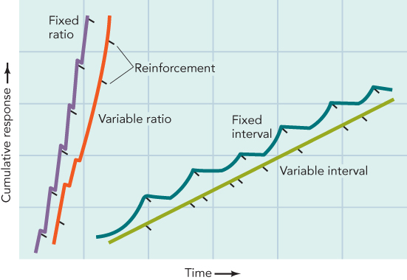
Figure 5.10 - Schedules of Reinforcement and Different Patterns of Responding

Slide 20
Punishment
Punishment decreases likelihood of behavior
Positive Punishment
Presentation (adding) of something unpleasant
Negative Punishment
Removal (taking away) of something pleasant

Slide 21
Operant Conditioning: Timing
Immediate vs. Delayed Reinforcement
Waiting for delayed, but more highly valued, reinforcers
Immediate vs. Delayed Punishment
Immediate more effective, but delayed can have effect
Immediate Reinforcement vs. Delayed Punishment
Immediate consequences usually win

Slide 22
Applied Behavior Analysis
Also called behavior modification
Use of operant conditioning principles to change human behavior
All human behavior understood as being influenced by rewards and punishments

Slide 23
Bandura’s Observational Learning
Also called imitation or modeling
Learning when behavior is observed and imitated
Vicarious Reinforcement & Vicarious Punishment

Slide 24
Figure 5.12 - Bandura’s Model of Observational Learning

Slide 25
Cognitive Factors in Learning
Purposive Behavior (Tolman)
Behavior is goal-directed
Expectancy Learning and Information
Latent (Implicit) Learning
Unreinforced learning not immediately reflected in behavior
Study: Rats in a maze

Slide 26
Cognitive Factors in Learning
Studies of Apes
“Stick Problem”
“Box Problem”
Insight Learning (Köhler)
Problem solving in which sudden insight, or understanding, occurs
Thinking “outside the box”

Slide 27
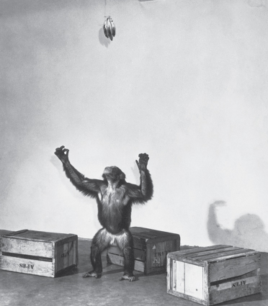
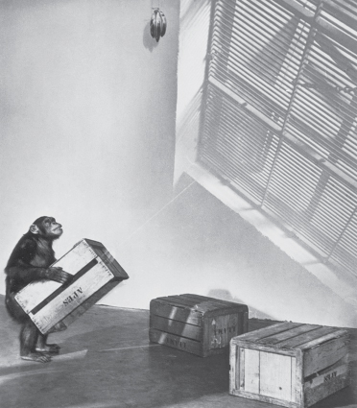
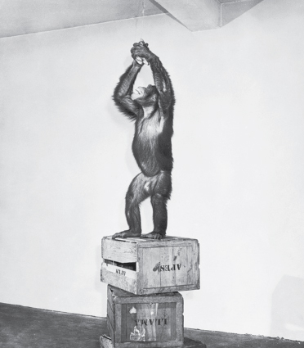
Figure 5.13 - Insight Learning

Slide 28
Biological Constraints in Learning
Structure of an organism’s body:
Permits certain kinds of learning
Inhibits other kinds of learning
Instinctive Drift
Tendency of animals to revert to instinctive behavior that interferes with learning
Preparedness
Species-specific biological predisposition to learn in certain ways but not others

Slide 29
Cultural Influences in Learning
Principles of conditioning and learning are universal
Culture can affect the degree to which various learning processes are used
Culture can determine content of learning

Slide 30
Psychological Constraints in Learning
Mindset
Describes way beliefs about ability dictate goals
What we think we can learn → What we do learn
Fixed Mindset
Belief that qualities cannot change
Growth Mindset
Belief that qualities can change/improve through effort

Slide 31
Strategies for Developing a Growth Mindset
Understand that your intelligence and thinking skills are not fixed but can change
Become passionate about learning and stretch your mind in challenging situations
Think about the growth mindsets of people you admire
Begin now

