Slide 1
Chapter 2 Sex Research: Methods and Problems

Slide 2
Goals of Sexology
The study of sexuality
Goal is to:
Understand sexual behavior
Predict sexual behavior
Control / Influence sexual behavior
Ethical considerations when controlling behavior
Is applying research findings to control or modify behavior a legitimate aim of sex research?
Notes:
Compared with many other disciplines, sexology is an infant science, having originated largely in the 20th century

Slide 3
Early Sexuality Research
Variety of disciplines
Focus on abnormal and unhealthy practices
Victorian period (19th century) suspended sexuality research until physicians made it an appropriate topic as related to medicine
Primarily studied in Germany

Slide 4
Early Sexuality Research
Early 20th century it earned legitimacy with Freud, Ellis, and Bloch
Moved to the United States in 1920s, encouraged by the social hygiene movement
Limited funding for research

Slide 5
Recent Sexuality Research
Late 1980s, early 1990s increase in sexuality research
Prompted by HIV/AIDS
Primarily “problem-driven” research, not healthy sexuality
Pressure from conservative groups
Multiple disciplines studying sex has fragmented research

Slide 6
Recent Sexuality Research
Popular media sensationalizes and distorts information
Sexologist – researcher, educator, clinician specializing in sexuality; usually PhD
Researchers feel pressure to research select topics and avoid others
Academic programs specializing in human sexuality; need steady funding

Slide 7
Sexuality Researchers
Early promoters of sexology: Bloch, Moll, Hirschfeld, Krafft-Ebing, Ellis
Sexuality research in the United States: Mosher, Bement Davis, Kinsey, Hunt, Masters & Johnson, Hooker, Bell & Weinberg, Janus & Janus, Laumann et al.
Age-specific studies: teens, seniors

Slide 8
Early Promoters of Sexology
Bloch (1872-1922): Published the Journal of Sexology beginning 1914
Moll (1862-1939): In 1913, began the International Society for Sex Research; authored sexology books
Hirschfeld (1868-1935): Worked to better the treatment of homosexuals and bisexuals; developed an Institute for Sexology

Slide 9
Early Promoters of Sexology
Krafft-Ebing (1840-1902): Sexual pathology
Ellis (1859-1939): Published six-volume work on sexuality; refuted deviance of homosexuality and masturbation
All early researchers legitimized the study of sexuality
Findings lacked consistency and organization

Slide 10
Sexuality Research Moves to the United States
Two pioneering female researchers:
Mosher (1863-1940): First to ask Americans about their sexual behavior; helped married women have better sex lives
Bement Davis (1861-1935): Prostitution and STIs; homosexuality is not abnormal

Slide 11
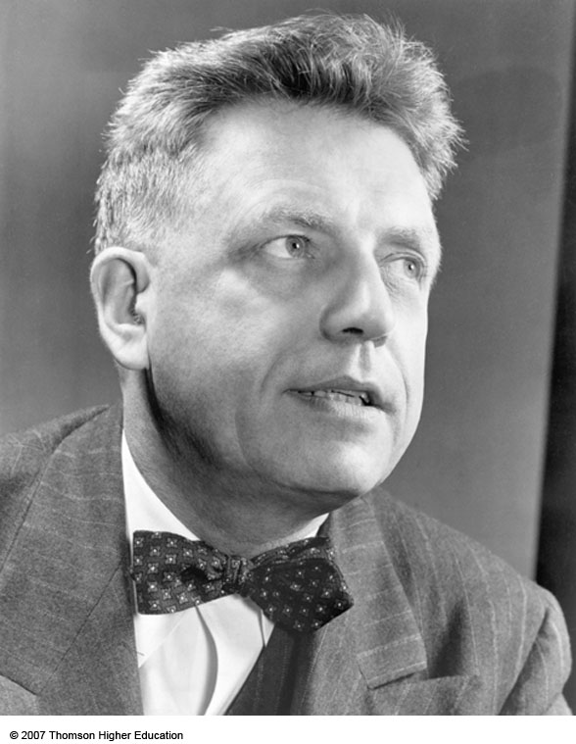
Alfred Kinsey (1894-1956) implemented the first large-scale survey of adult sexual behavior in the United States.

Slide 12
Kinsey: Large Scale Sexuality Research Begins in the U.S.
Most influential modern sexuality researcher
Atheoretical in the beginning because data on sexuality was lacking
He and 3 colleagues interviewed 18,000 subjects to obtain sexual life histories
Preferred use of 100% sampling
1947, established the Institute for Sex Research

Slide 13
Kinsey: Large Scale Sexuality Research Begins in the U.S.
1948: Sexual Behavior in the Human Male
1953: Sexual Behavior in the Human Female
Found many unacceptable activities to be widely practiced
Controversial work; had funding sources taken away

Slide 14
Sexuality Research in the United States
Hunt: Playboy Foundation study of American sexual behaviors (1974); volunteer bias

Slide 15
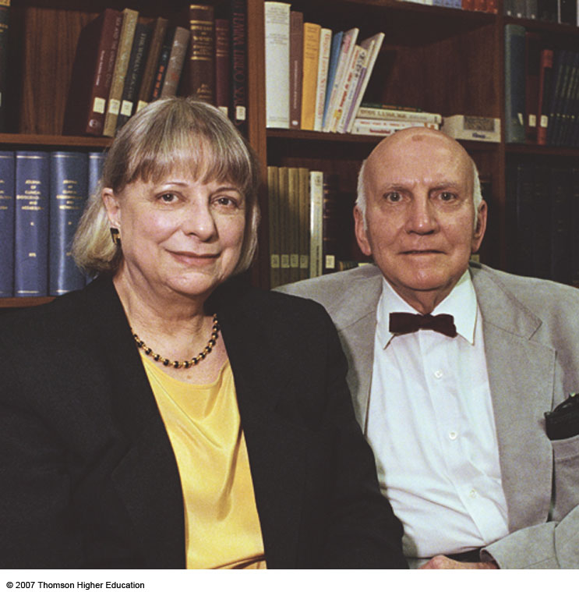
Virginia Johnson and William Masters were the first to bring sexuality into the laboratory.

Slide 16
Sexuality Research in the United States
Masters & Johnson: In 1954, began to study the anatomy and physiology of intercourse in the laboratory
Electrocardiograph
Electromyograph
Penile strain gauges
Photoplethysmographs

Slide 17
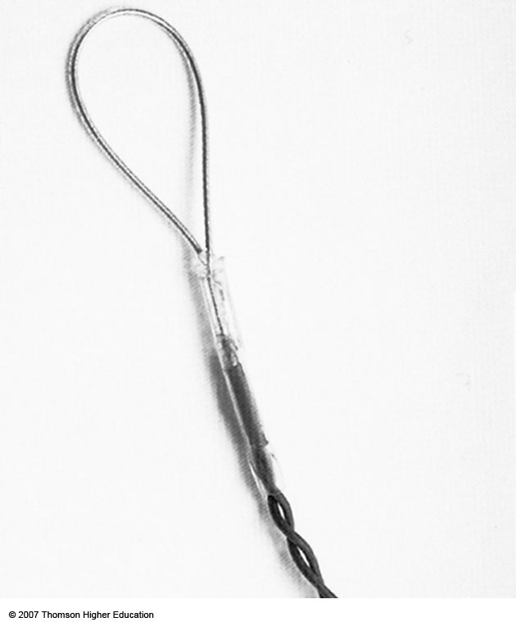
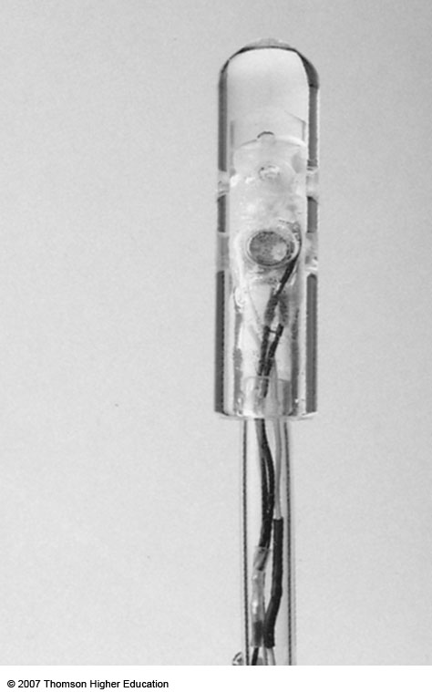
Changes in penile erection and vaginal lubrication were measured with penile strain gauges and photoplethysmographs.

Slide 18
Sexuality Research in the United States
Masters & Johnson: Human Sexual Response (1966)
Four stage model
Women may have multiple orgasms
Sexuality stays with us as we age
Masters & Johnson: Human Sexual Inadequacy (1970)
Vaginal orgasms from clitoral stimulation

Slide 19
Sexuality Research in the United States: Homosexuality
Few large-scale studies
Hooker: Early 1950s; professionals could not differentiate gay and straight males
Bell & Weinberg: Homosexualities (1978)
majority of homosexual men and women do not conform to stereotypes
aren’t sexual predators
homosexuals and heterosexuals are similar in intimate relationships

Slide 20
Sexuality Research in the United States
The Janus Report (1993): large survey on sexual behavior in the U.S.; sectioned out regions in the U.S.; not a random sample
National Health and Social Life Survey, Laumann, Gagnon, Michael, & Michaels (1994): Surveyed a representative sample of the U.S. on sexual behaviors and attitudes

Slide 21
Sexuality Research in the United States: Age-Specific Studies
Teens
National Institute of Child Health and Human Development (2002)
National Survey of Adolescent Males (2002)
Seniors
Starr & Weiner (1981): Sexuality still important for seniors
Love, Sex, and Aging (1984)

Slide 22
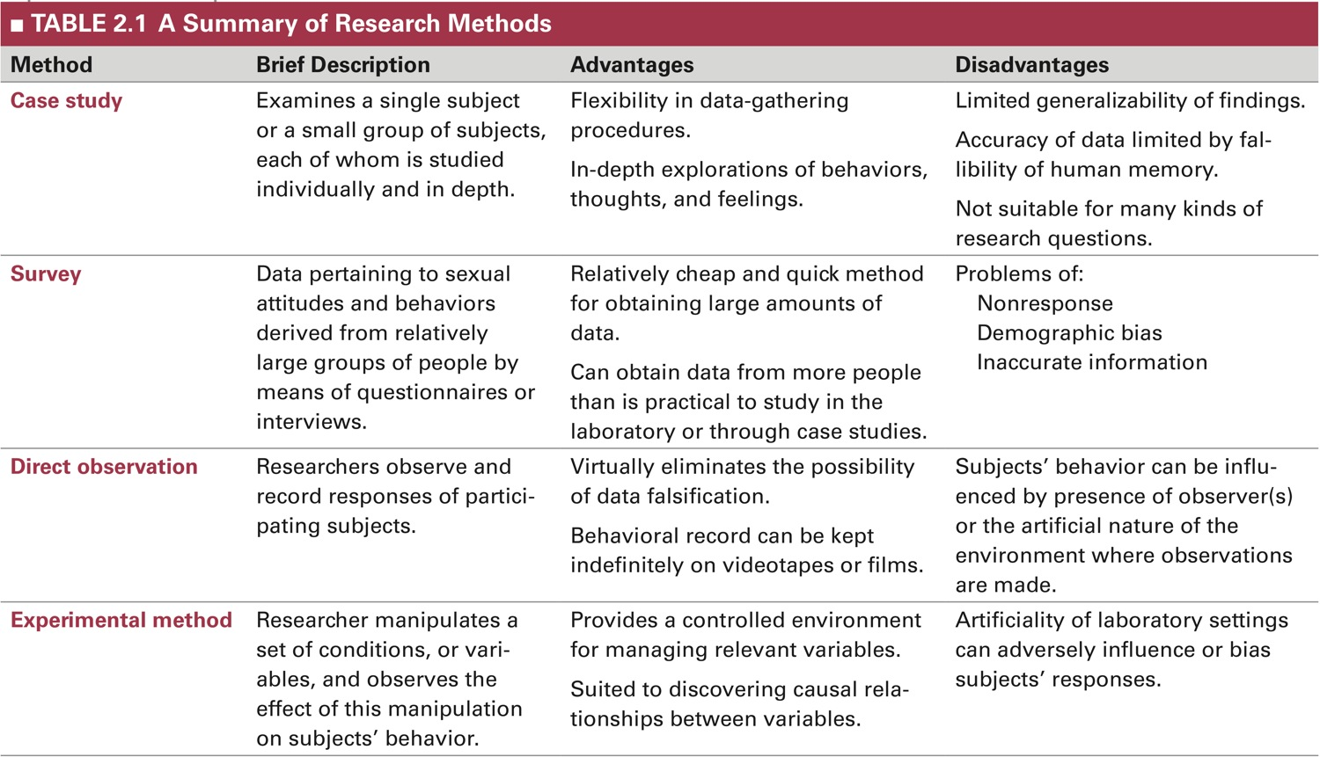
A Summary of Research Methods

Slide 23
Non-Experimental Research Methods: Case Studies
Single subject or small group
Each studied individually and in depth
Data gathered using:
Direct observation
Questionnaires
Testing
Experimentation

Slide 24
Non-experimental Research Methods: Case Study
Advantages:
In depth explorations
Flexibility in data gathering procedures
Disadvantages:
Hard to generalize results
Often based on retrospective self-report
Not suitable for many research questions

Slide 25
Non-experimental Research Methods: Survey Methods
Small to large samples of people
Data gathered using:
Face-to-face interviews
Questionnaires
Can be computerized or distributed online
Choosing the Sample
Representative sample
Random sample

Slide 26
Non-experimental Research Methods: Survey Methods
Advantages:
Questionnaires: anonymity may improve honesty, cheaper
Interviews: more flexible, rapport, may improve clarity & understanding
Disadvantages:
Non-response
Demographic bias
Inaccurate information

Slide 27
Non-experimental Research Methods: Survey Methods
Examples:
The Kinsey Reports
The National Health and Social Life Survey
The National Survey of Sexual Health and Behavior
The Youth Risk Behavior Survey
Violent Pornography and Alcohol Use survey
Notes:
Critical thinking questions: SHOULD THE FEDERAL GOVERNMENT FUND SEX RESEARCH? ARE THERE POTENTIAL BENEFITS FOR THE AMERICAN PEOPLE THAT JUSTIFY SUCH EXPENDITURES?

Slide 28
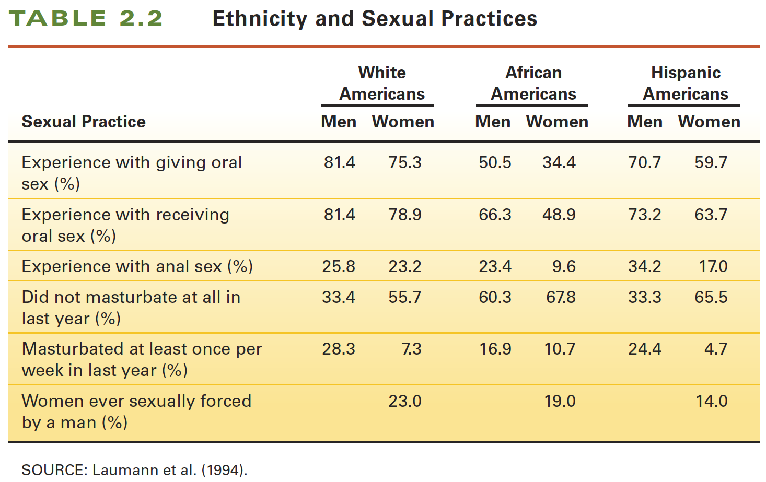
Non-experimental Research Methods Outcome from Survey Data
Notes:
Caption: Ethnicity and Sexual Practices.

Slide 29
Non-experimental Research Methods: Direct Observation Studies
Small to moderate samples
Observe and record responses of subjects
- Reliability increases with representative sample and accuracy of recording devices
Advantages:
Eliminates possibility of falsification
Records can be kept indefinitely
Disadvantages:
Self-selection, behavior influenced by observers, expense

Slide 30
The Experimental Method: Procedures
Small to moderate samples:
Independent variable
Condition or component that is manipulated
Dependent variable
Outcome or resulting behavior
Reliability and validity increase with:
Random selection
Random assignment

Slide 31
The Experimental Method
Advantages:
Lowers the influence of other variables
Can establish cause-effect relationships
Disadvantages:
Being measured may affect actions
Artificiality of laboratory setting

Slide 32
Technologies in Sex Research
Electronic devices for measuring sexual arousal
Penile strain gauge
measures slightest change in penis size
Vaginal photoplethysmograph
measures increased vaginal blood volume
Vaginal Myograph
Rectal Myograph
Notes:
How do researchers measure sexual arousal electronically?
Can computers and the Internet aid in gathering sensitive information?

Slide 33
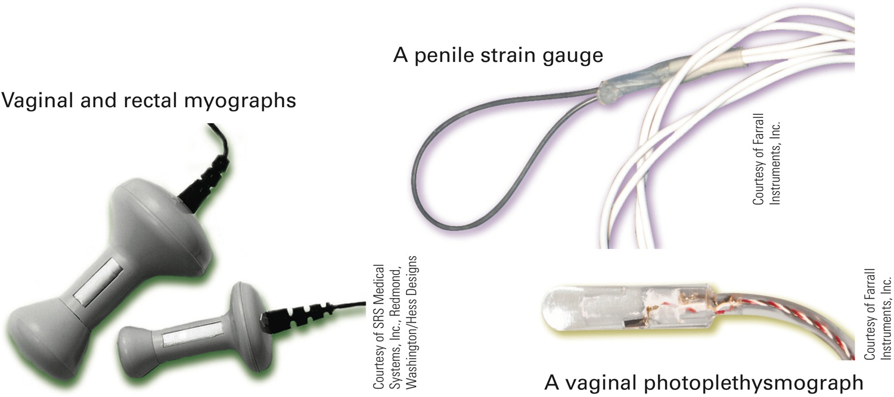
Measuring Sexual Arousal

Slide 34
Technologies in Sex Research
Computer assisted self-interview (CASI)
- Eliminates literacy issues and negative impact of interviewer; participants may prefer over face-to-face interview
Research in Cyberspace
Advantages: Cheaper and more efficient; nearly limitless survey pool
Disadvantages: sample selection bias, low response rates; privacy and ethical issues

Slide 35
Ethical Guidelines for Human Sex Research
No pressure or coercion for participation
Informed consent and voluntary participation
Confidentiality and anonymity
Question of deception
Institutional ethics review

Slide 36
Evaluating Research: Questions to Ask
Why was the research done? Who did the research? What are their credentials? What biases are there?
Who were the participants? How were they selected & assigned to groups?
How was the research conducted? What methods were used?
Where was the research reported? What additional support is there?
Notes:
To what degree can we rely on the findings of sex research?

